Slide 1
Clinic Management System(CMS)

Slide 2
CMS
This application consists of 3 major modules
Out Patient (OP)
Lab
Pharmacy

Slide 3
Out patient

Slide 4
Out Patient
This module maintains complete data of patients with high quality reports.
This module maintains complete medical record, patient prescription with investigations and treatment details.
Our Speech to Text feature helps doctors in documenting Doctor notes
Our Corporate Registration feature for credit patients helps in handling Corporate Out Patients.

Slide 5
Patient Management Flow Chart
Diagram:
Patient Management
Initial Setup
Out Patient
Corporate Registration
Reports
1.Allergy setup
2.Procedure setup
1.Patient Queue
2.Appoinments
3.View bills
4.Patient TAT
1.Corporate
Registration
2.Credit Lab Billing
1.Dash Board
2.Patient Reports
3.Revenue Reports
1.Initially allergies and procedures have to be set up. Doctors and employees are also registered.
2.Doctor availability and service charges also set for the doctors before generating appointment to the
Patient.
3. Our reports cover patient details day-wise, month-wise and year-wise

Slide 6
Out Patient Screen Flow

Slide 7
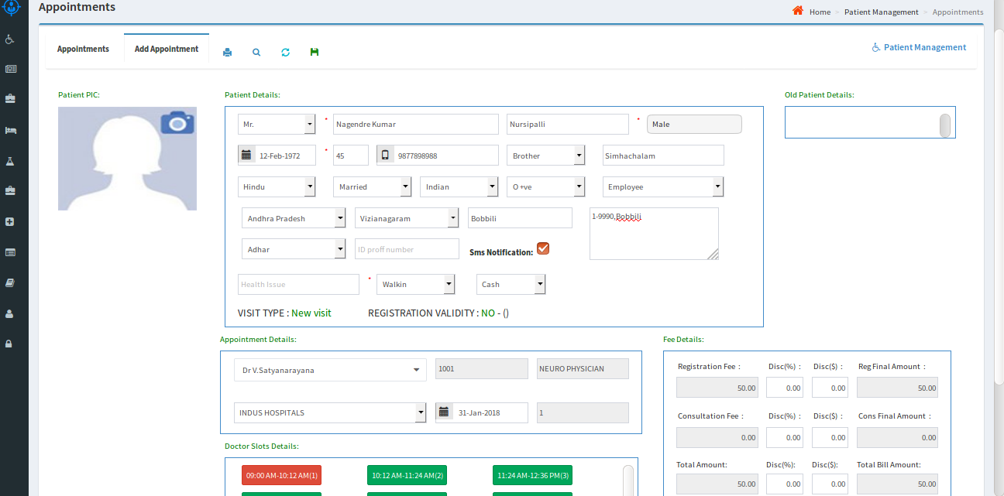
OUT PATIENT
Patient Queue: By using this page new patients can be registered and appointments for those patients can be generated at a selected time-slot.
Appointments for old patients with valid registration can also be generated.
Doctor availability slots can also be updated in the system depending on the availability of the doctor.

Slide 8
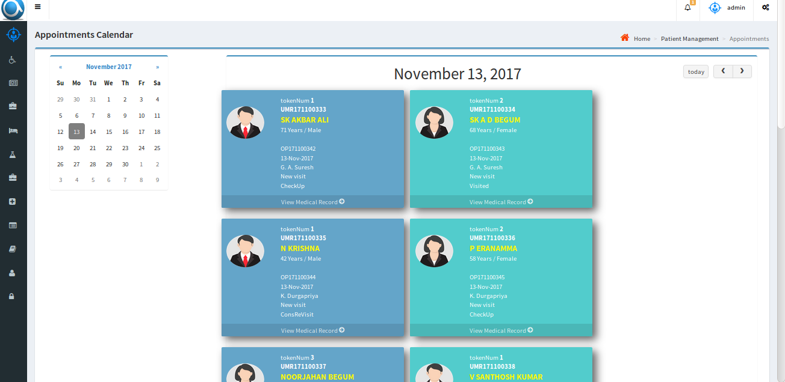
Appointments
Appointments: By using this page, Day-wise appointments for particular doctor can be viewed.
Patient image along with other details like medical record can be accessed.

Slide 9
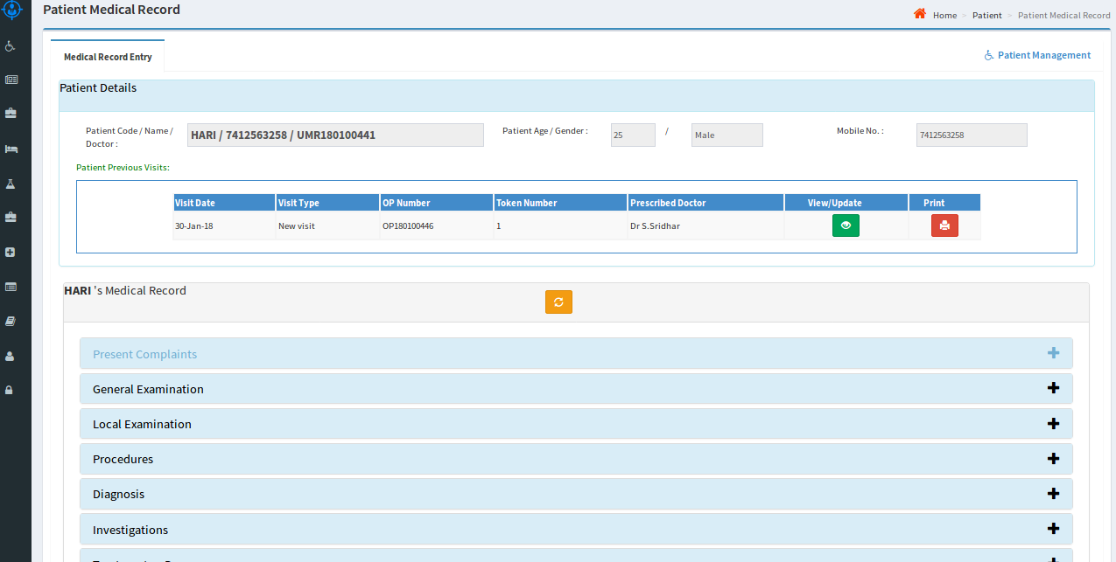
Medical Record
Medical Record: Complete patient medical record can be accessed from this page.
The doctor can use Speech to Text feature to write notes, prescription etc.,

Slide 10
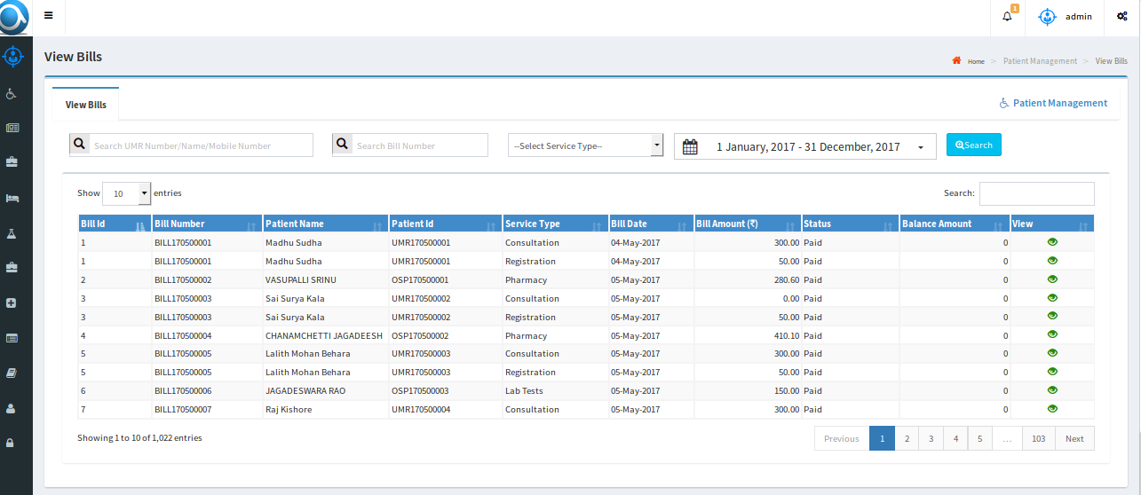
View Bills
View Bills: All bills for a selected period along with patient appointments and registrations are displayed.
Detailed view is also available for a selected list item.

Slide 11
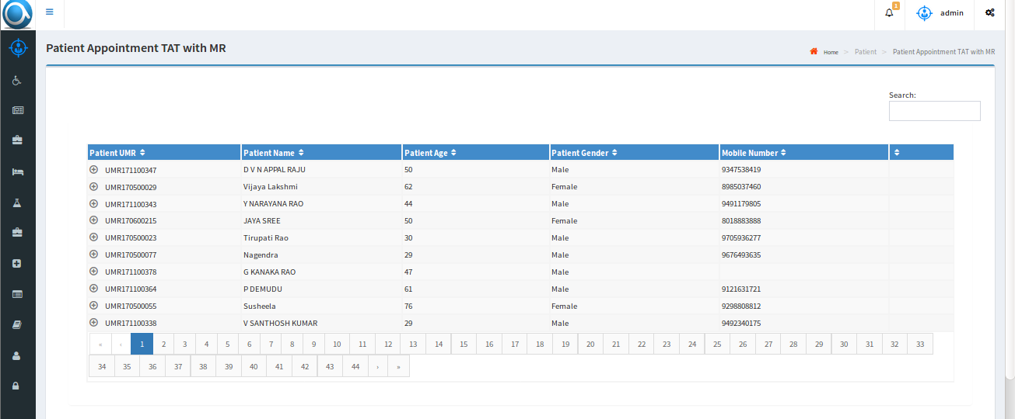
TAT Report
Tat report: Here we have detailed report of the patients about how much time they spent in hospital, including lab and pharmacy.

Slide 12
Pharmacy

Slide 13
Pharmacy
We have two flavors of pharmacy application, one for independent pharmacy and one for pharmacy associated with a hospital.
This application covers end to end flow from receipt of stock from stockiest to selling of drugs, billing with GST, alert with list of drugs which reached below the defined threshold limit, various reports encompassing current stock, sales for a selected period etc.,
Our advanced option supports Multi-location pharmacies, return of purchased drugs with credit voucher option, SMS alerts to registered patients

Slide 14
PHARMACY MODULE
Initial Setup
Stock Inventory
Drug issue & Bills
Reports
Stockist Setup
Drug setup
Generic setup
Sales Returns
Pharmacy Sales
Stock invoice
Stock Receipts
Return Stock
Sales Reports
Purchase Report
Stock & sales Report
Expiry drugs Report
Reorder Reports

Slide 15
Pharmacy Screen Flow

Slide 16
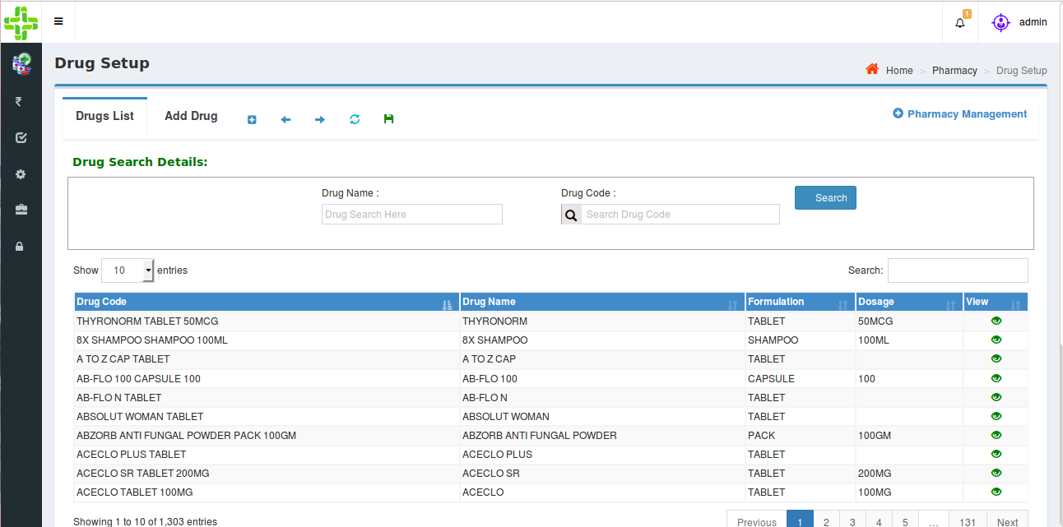
Pharmacy Flow
Drug Setup:
Users can add drug details as well as Generic drugs and setup threshold limit for each drug.
Users can view/edit all the entered drug details.
INPUT PARAMETERS : Drug Name, Formulation, Dosage, HSN Code, MRP, GST %
OUPUT PARAMETERS : Identical to input parameters, which navigates to stock receipts, sales and report screens.

Slide 17
Pharmacy Flow
Stockist Setup:
- Users can add the details of Stockists.
- Users can view/edit all the entered Stockists.
INPUT PARAMETERS – Stockist Name, GST Number, Contact Details.
OUTPUT PARAMETERS – Stockist Name, which navigates to Stock Invoice.
Generic Setup:
- A drug without brand name is a Generic. Every individual drug has its own generic name.
- Users can add, edit the generics.
INPUT PARAMETERS - Generic Name.
OUTPUT PARAMETERS - Generic Name navigates to Drugs Setup Screen.

Slide 18
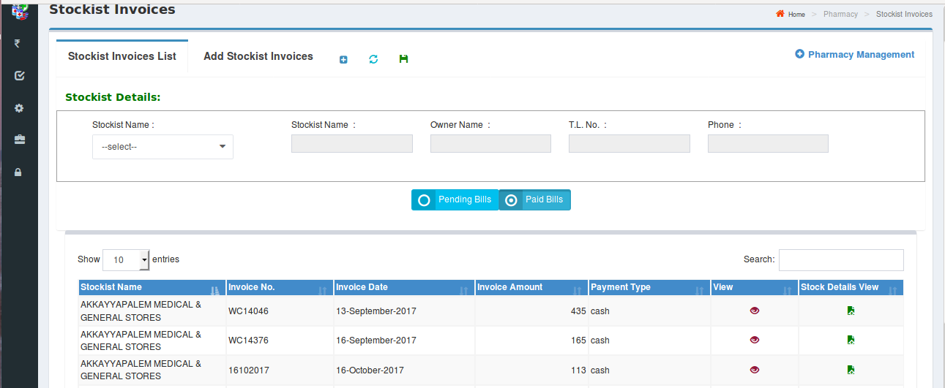
Pharmacy Flow
Stock Invoice:
- Users can add invoices for selected stockist
- Users can view invoices; invoice details and drug details entered under particular invoice
INPUT PARAMETERS – Invoice Number, Invoice Date, Gross Amount, Payment Type, Discount Percentage, Discount Amount, SGST Amount, CGST Amount, GST Amount, Final Invoice Amount.
OUTPUT PARAMETERS – Identical to input parameters, navigates to Stock Receipts and Return Stock.

Slide 19
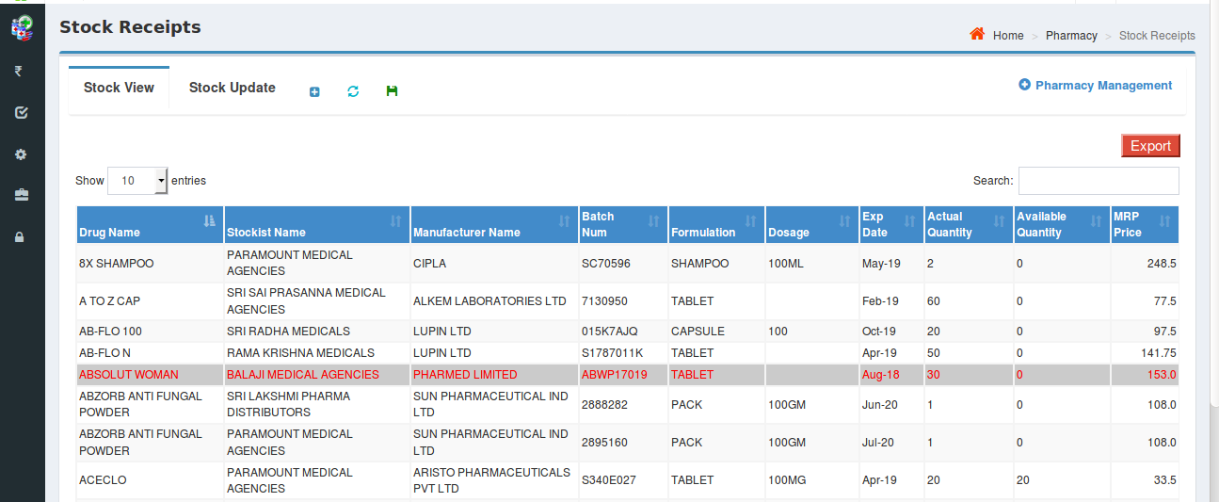
Pharmacy Flow
Stock Receipts:
Users can enter details of received stock depending on the respective stockist and invoice number.
INPUT PARAMETERS - Batch Number, Expiry Date, Quantity, MRP, Distributor Amount.
OUTPUT PARAMETERS - Identical to input parameters, navigates to Sales, Return Stock and Reports respectively.
Drugs which are about to expired are indicated with a specific color.

Slide 20
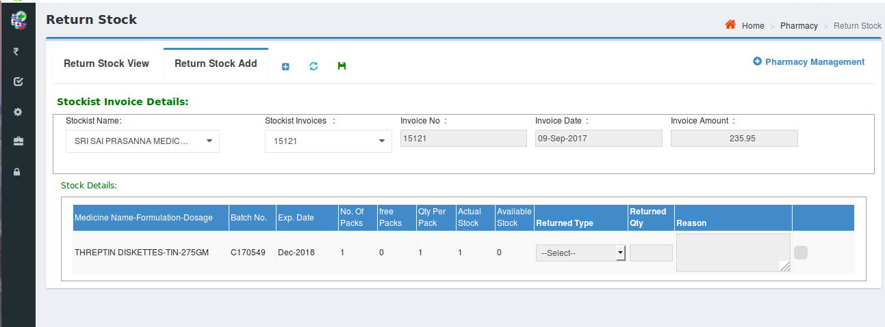
Pharmacy Flow
Return Stock:
The retail pharmacy user can return drugs to the stockist either fully or partially under selected invoice.
Returned stock can either be damaged or not moveable drugs.

Slide 21
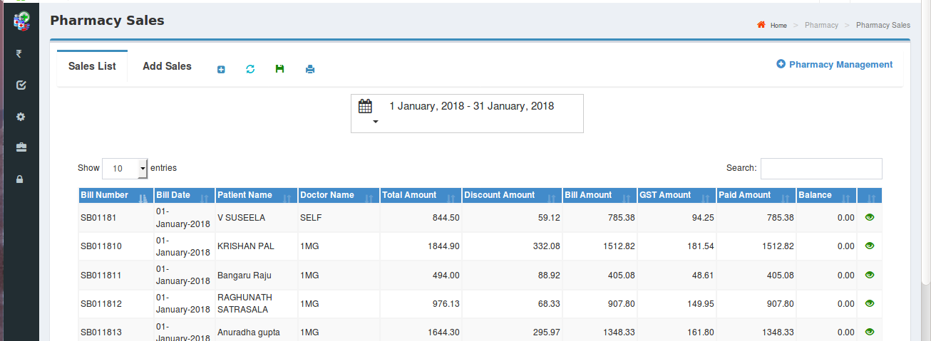
Pharmacy Flow
Pharmacy Sales:
- The retail sale details along with the details of the patient can be captured.
- The details of retail sales for a selected time period can be viewed.

Slide 22
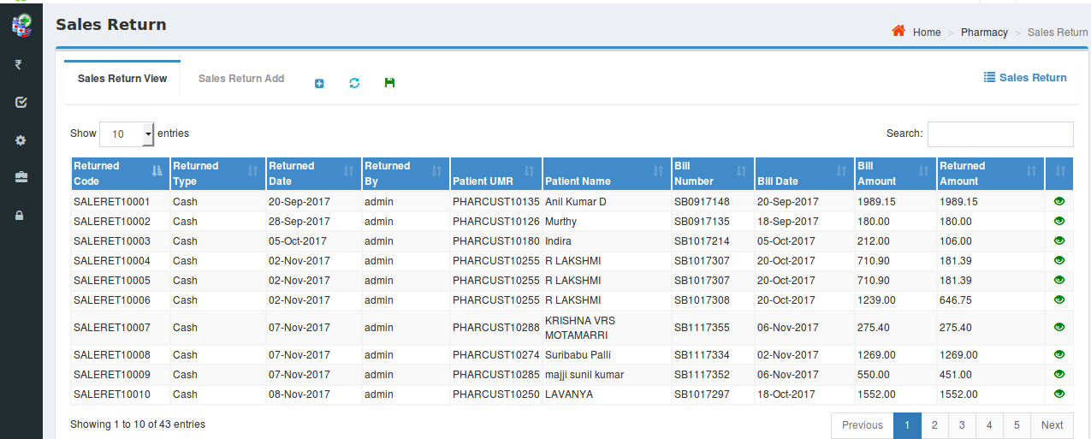
Pharmacy Flow
Sales Return:
- The details of the returned medicines by a patient can be captured
- The list of returned medicines along with other details can be viewed

Slide 23
Pharmacy Flow
Reports:
Our application covers various kinds of reports and some of them are as follows:
Sales Report: Summary and detailed description of sales for a selected referral/Doctor and for a selected time period.
Purchase Report: Summary and detailed description of the purchases for a selected time period.
Stock and Sales Report: Drug wise purchased quantity/value, sales quantity/value, stock and ‘Value of stock on hand’ are populated in this report
Expiry Drugs Report: Details of expired drugs are generated in this report.
Re-order Report: The list of drugs whose quantity is below the threshold limit are displayed so as to be re-ordered
All reports have options to ‘Export to Excel’ and ‘Export to Pdf’

Slide 24
Pharmacy Reports

Slide 25
Pharmacy Reports

Slide 26
Medical Lab

Slide 27
Medical lab
We have two flavors of lab application, one for basic lab for small labs covering basic tests and one for advanced lab covering advanced tests.
Our lab application covers functionality for independent lab as well as lab associated with a hospital with functionality to associate lab results with patient record which is helpful to maintain a record of the patient’s lab results for necessary retrieval any time.
Our lab application covers end to end functionality from patient registration to completion of tests including lab billing, storage of lab test results etc.,
Our lab application covers various reports encompassing patient lab report history, referral doctor wise reports, Billing details reports etc.,

Slide 28
Lab Screen Flow

Slide 29
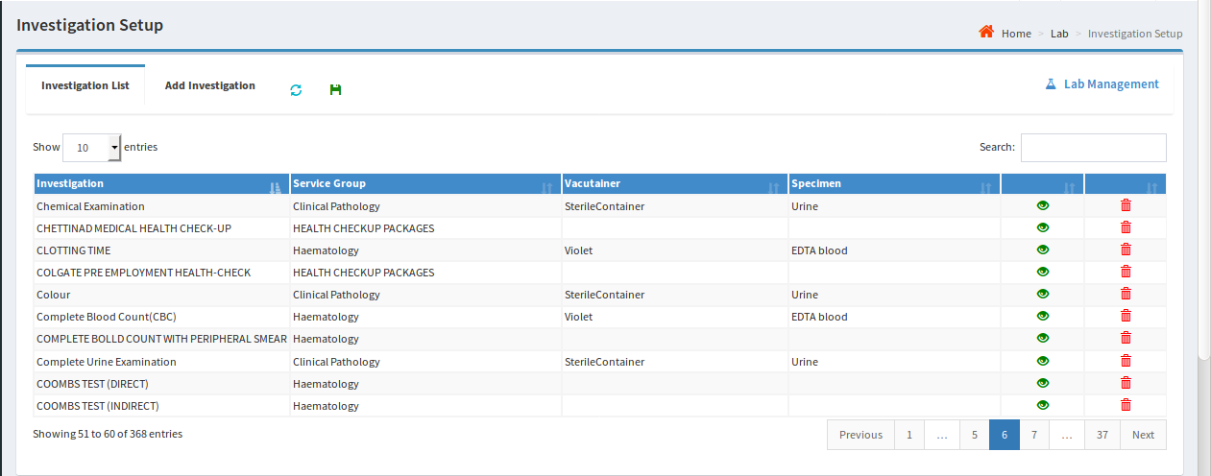
Lab Flow
Initial Setup:
-The following entities can be set up through Atri’s Lab application
Department : Internal departments can be added, viewed and edited like Laboratory, X-ray, Radiology etc.,
Service Group : Service groups can be added for multiple investigations. User can view and update.
Vacutainer : User can add, view and update containers to collect samples.
Specimen : User can add, view and update samples like Blood, Urine, Sputum etc.,
Investigation : Investigations can be added by mapping all above i.e., department, service group, vacutainer and specimen. And user can view and update existed list of Investigations.
Investigation Parameter: Individual parameters are mapped to respective investigation.
Package: Mapping of multiple service groups to respective investigations.

Slide 30
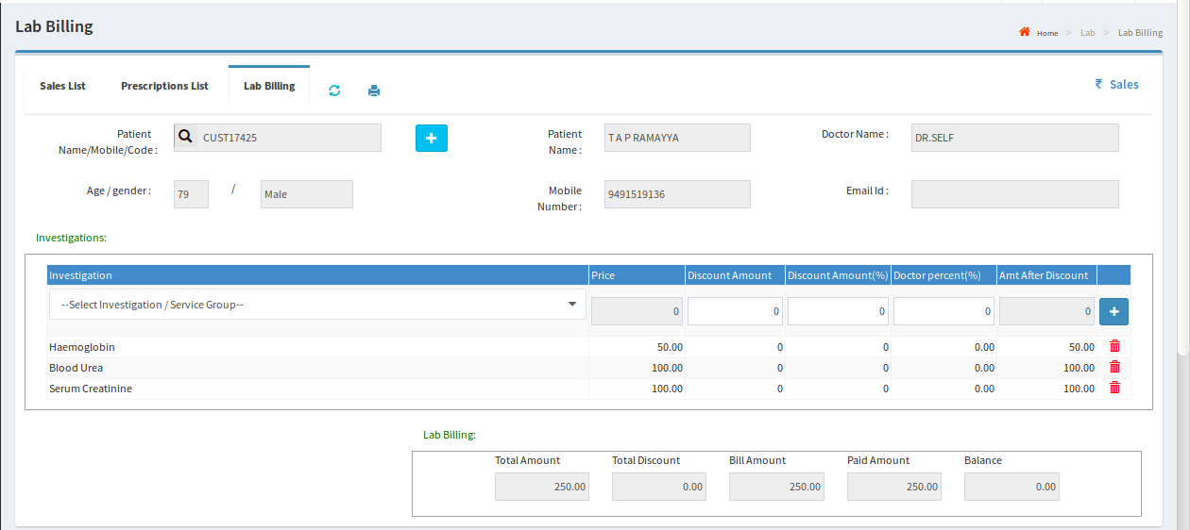
Lab Billing
Patient details and Lab test details are captured and the patient is billed for the identified tests.
Once payment is done, status will change from pending to paid.

Slide 31
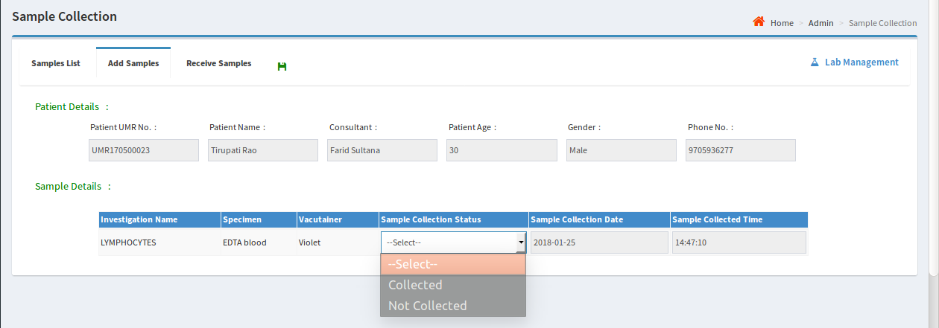
Sample Collection
Once Billing is done, the patient will go for sample collection.
The status of the sample will be updated to ‘Collected’ as soon as the sample is collected.

Slide 32
Result entry

Slide 33
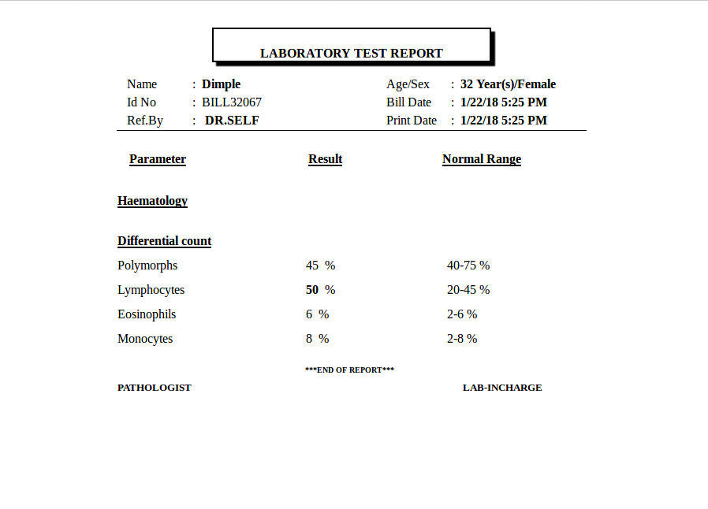
Result View
After saving the results of investigations, user can take printout of the report.

Slide 34
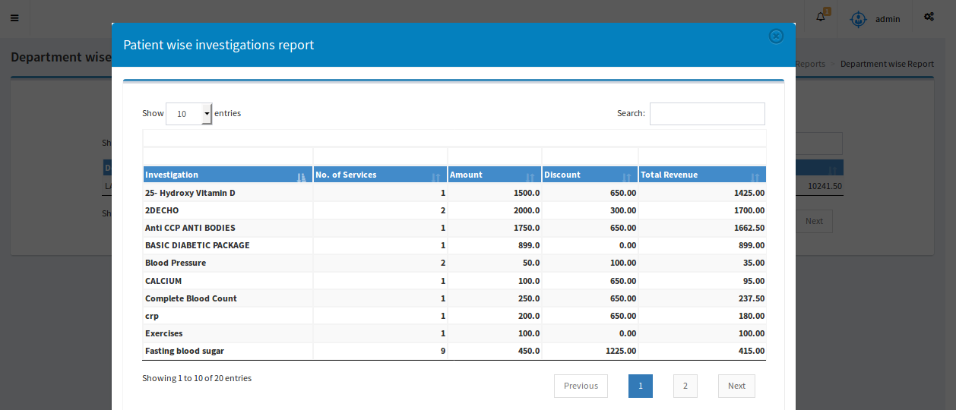
Reports
Our application covers various kinds of reports and some of them are as follows:
Revenue Report: Displays total income for a selected time period.
Doctorwise Report: Displays doctor wise total income for a selected time period.
Departmentwise Report: Individual department with multiple investigations reports are listed.

