Slide 1
Atri Ticketing System (ATS)

Slide 2
ATS
As the organization grows, it becomes difficult to have smooth business process as communication becomes difficult without proper ticketing system
Our ticketing system addresses this issue and helps in smooth running of the business by providing proper workflow to address any issues
Tickets can be assigned to the right person when they arrive and can be reassigned to another person, if needed.
Our ticketing system provides various reports which can be used to identify the pain points in the system and make necessary corrections

Slide 3
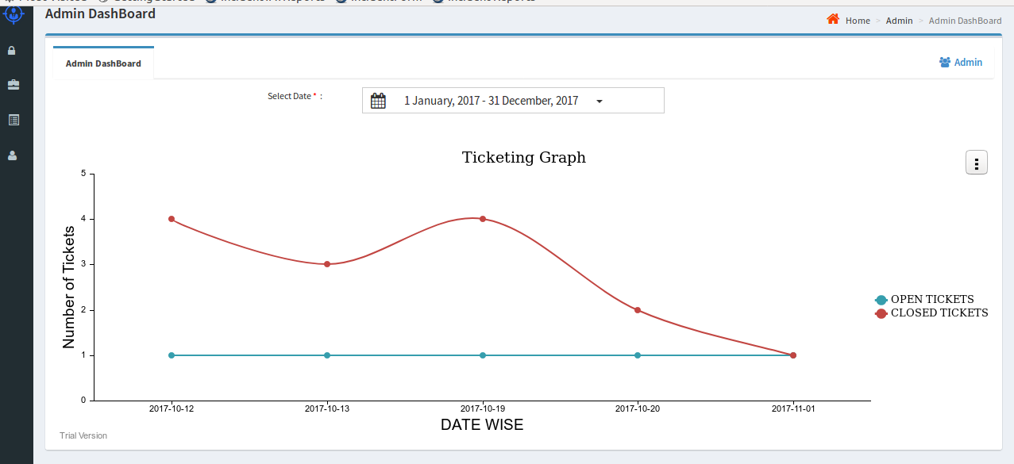
ATS Dash Board
ATS Dashboard displays count of tickets in graphical mode for the selected time period.
The Graph can also be exported to JPEG or PNG format.

Slide 4
Atri Ticketing System Screen Flow

Slide 5
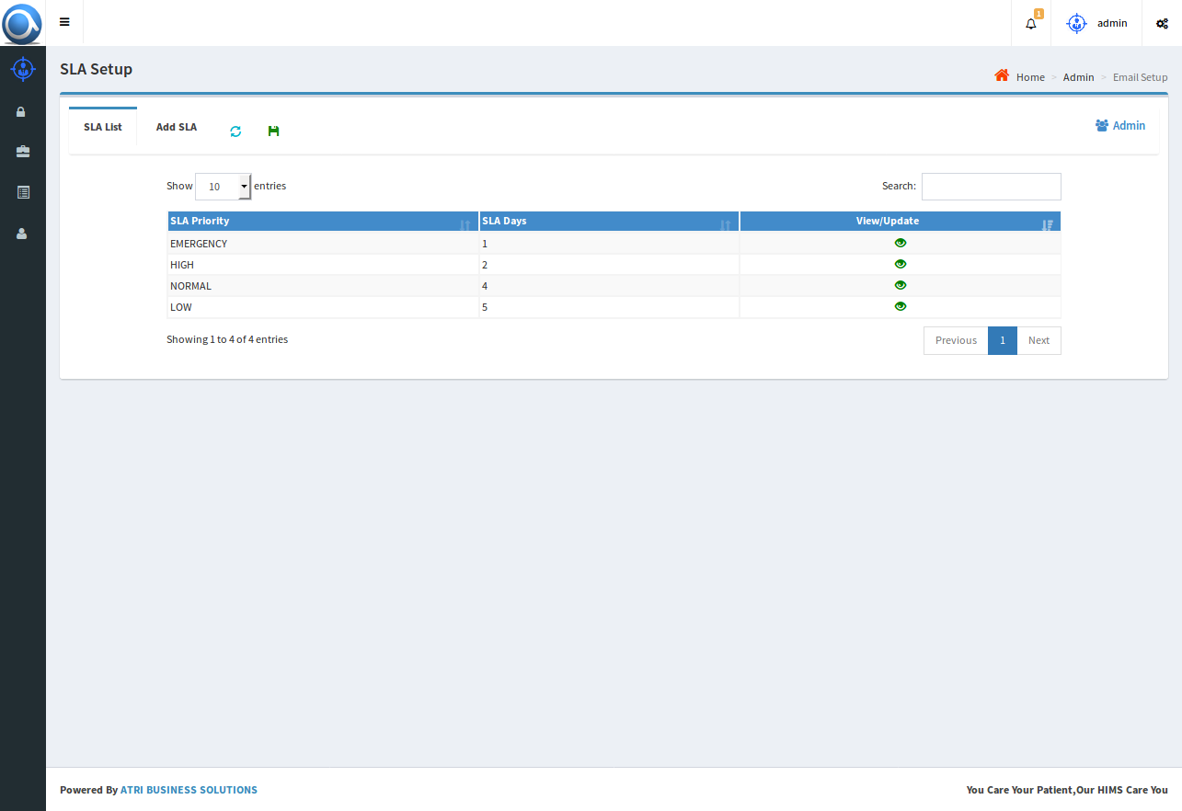
SLA Setup
Service Legal Agreement for each priority level can be defined
If ticket is not closed within the SLA timeline, the ticket will be automatically move into Overdue State.

Slide 6
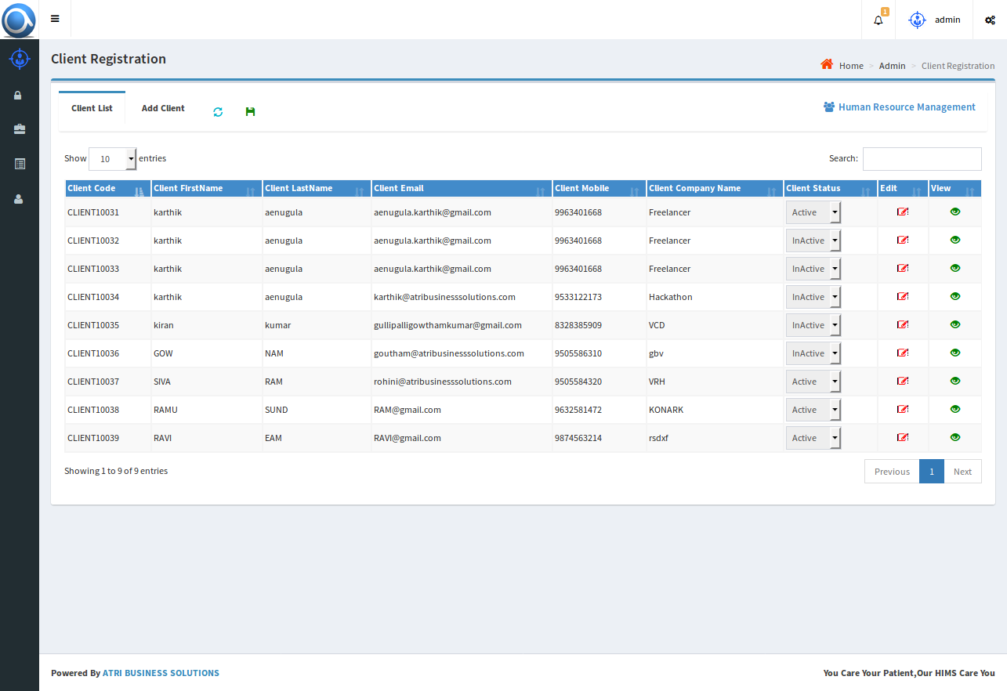
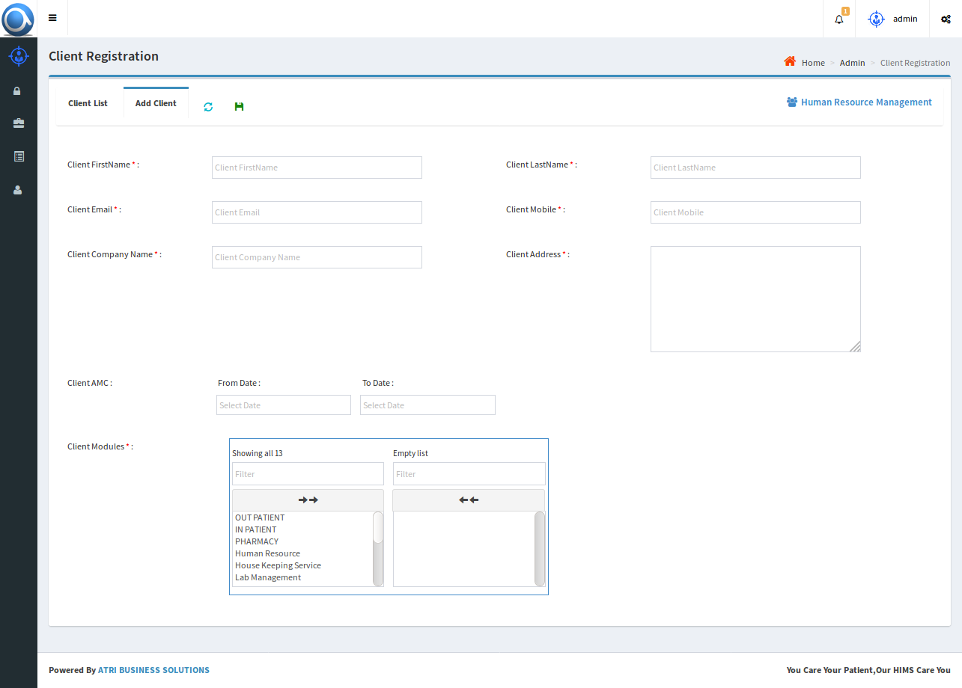
Client Setup
Admin registers new clients by giving first name, last name, email, mobile, etc., Unique Code is generated for every Client the same is used as Username

Slide 7
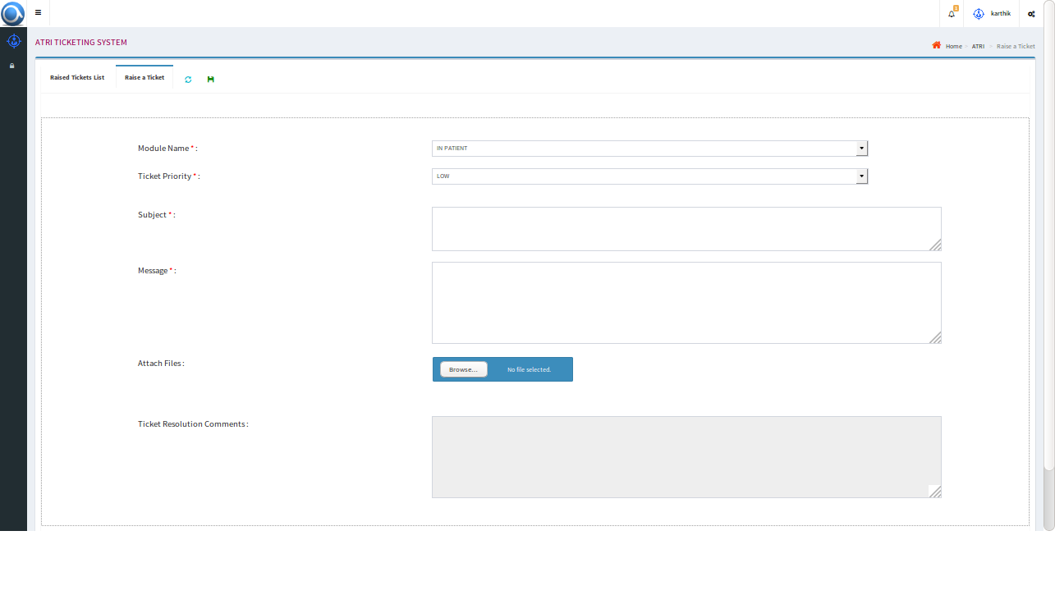
Client Panel
Client logins and raises a ticket that may be a requirement or an issue by giving details like ticket priority, module, Subject, Message, related attachments etc.,
Each ticket gets a unique number and a notification is sent to Atri admin
Client can view all the tickets raised by him and can check the status of any ticket.
Client can see only tickets raised by him.

Slide 8
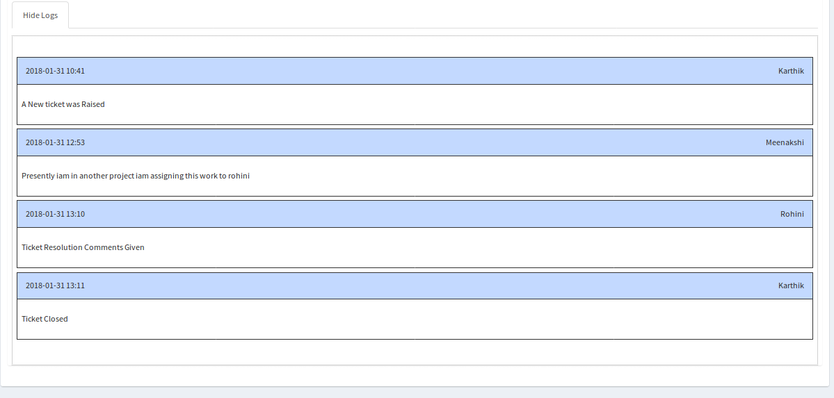
Logs
Log of each action for each ticket is saved

Slide 9
Reports
ATS Consists of multiple reports like TAT Report, List of tickets for selected employee or status or priority etc.,
TAT Report

