Slide 1
Linen Management

Slide 2
Linen Management System
One more big challenge in hospital management is linen management as it is the easiest item for pilferage.
Our LMS application makes it possible to track each and every piece of linen right from purchase to condemnation covering stocking in central store, issue to various wards/departments, issue for washing etc., using barcode scanning mechanism.
Our LMS application can track the location of each and every piece of linen at any point of time thus reducing the scope for any pilferage, thus saving considerable money by avoiding possible pilferage.
Our LMS application covers variety of reports which help in determining the life cycle of each and every piece of linen, the durability, number of washes linen piece is withstanding etc., which help in making wise business decisions.

Slide 3
Linen Dashboard

Slide 4
Linen Management screen flow

Slide 5
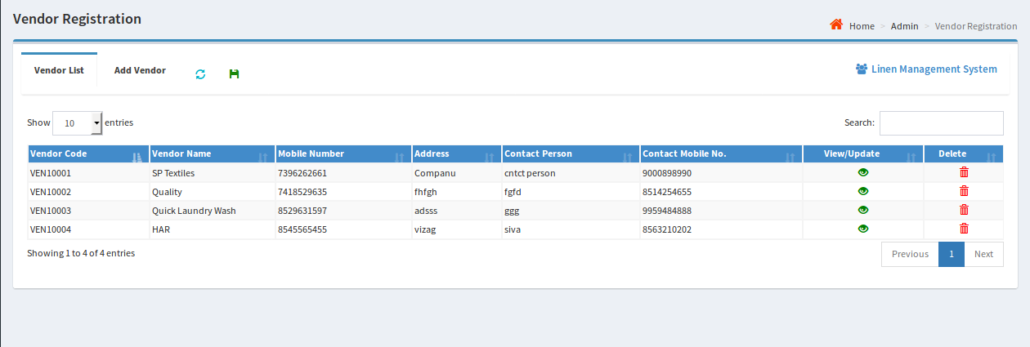
Initial Setup
Item Setup: Any linen item like Bed-sheet, Pillow Cover, Blankets etc., can be added into the system and can also be edited for any necessary corrections
Vendor Registration: Users can add and edit the details of vendors and quotations can be requested from the saved vendors from Request for quote screen.

Slide 6
Procurement Flow
Request For Quote: Procurement In-charge can raise quotation for different number of items with respective quantities and estimated price to multiple Vendors resulting with a unique code(Rfq Code) for every individual raised quotation.
Receive Quotes: Vendors send their quotes in response to the RFQ and each quote will have unique Quotation number.
Approve Quotation: Procurement In-charge will approve the best quotation.
Purchase Order: Once quote is approved, Procurement In-charge can select respective vendor and enter details of item, price etc., which results in generation of a unique PO number.

Slide 7
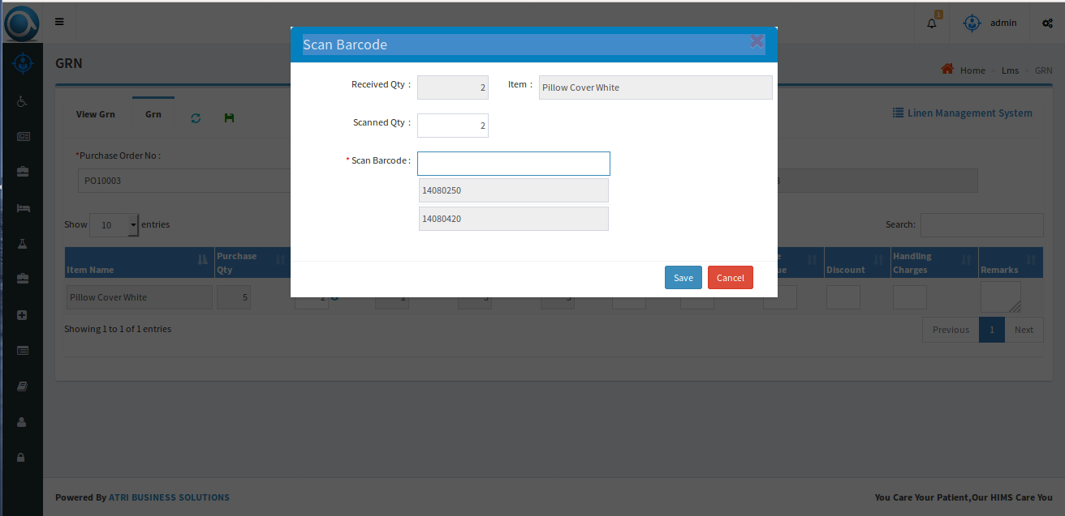
Goods Receive Note(GRN)
Once vendor sends the material, GRN is generated and stock is updated in Central Store.
Each item being received in Central Store gets a barcode label with unique barcode number.

Slide 8
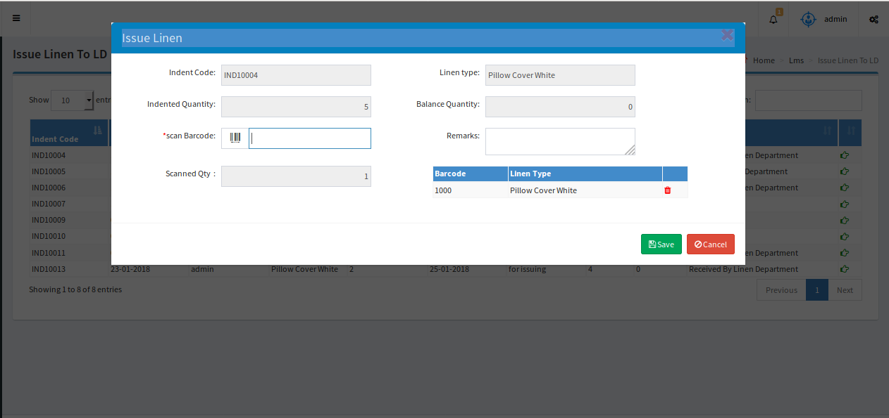
Indent Process
Indent Linen:
Users from different departments can raise indents by selecting particular item and quantity which results in generation of a unique Indent-Code.
Issue Linen to Linen Department(LD): Central Store can issue requested linen to Linen Department against the Indent-code after scanning the barcode of the particular item.

Slide 9
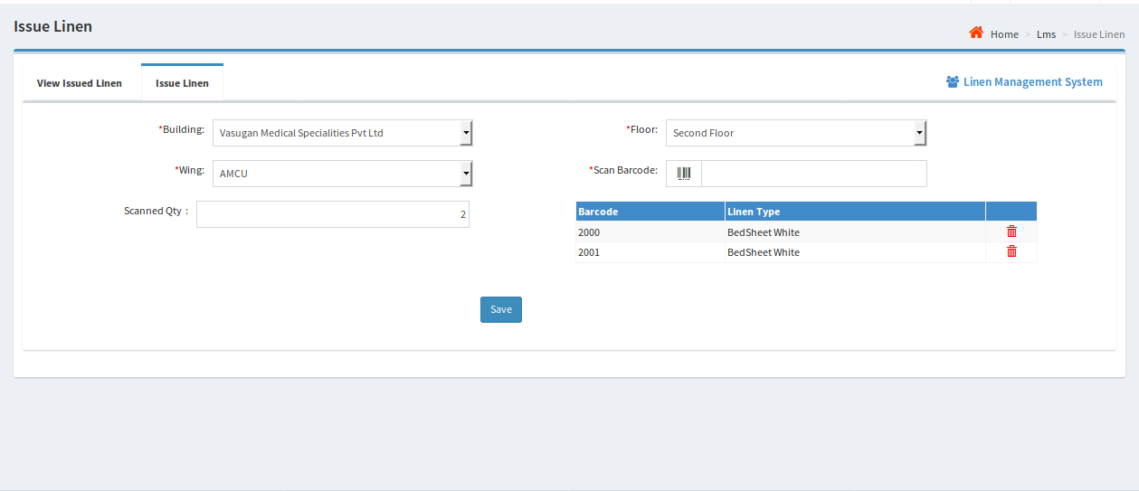
Issue Linen to Wards
Upon requests received from wards, the requested linen is issued to the wards

Slide 10
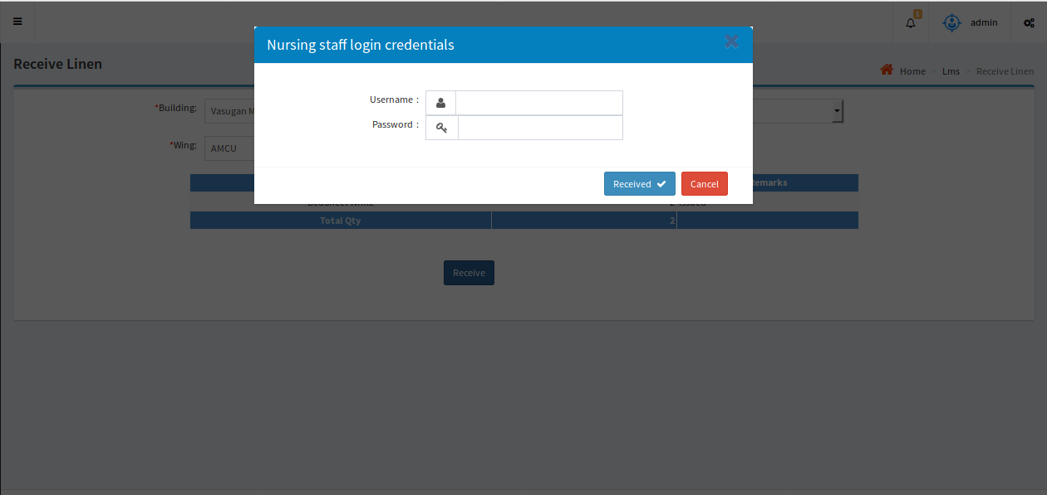
Receive Linen by Nursing Staff
The issued linen is received by the nursing staff of the concerned department.

Slide 11
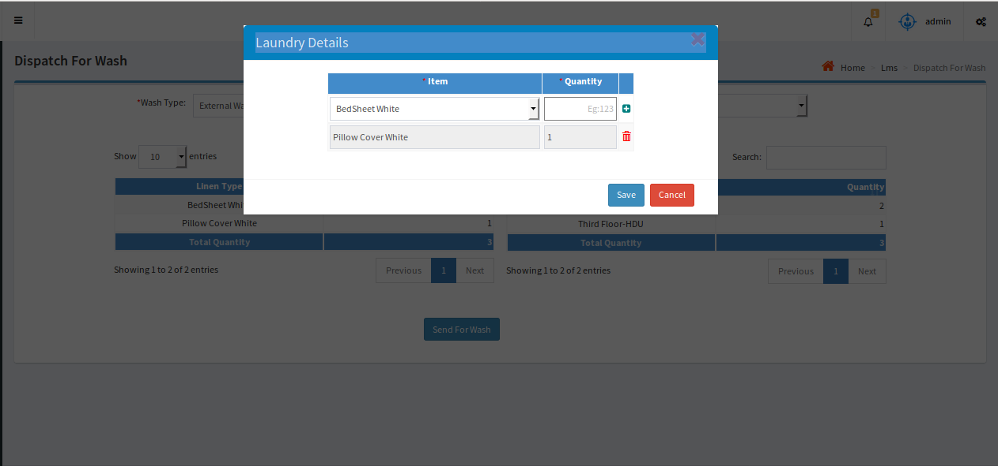
Laundry Process
Collect Used Linen:
Nursing staff will scan barcode of used material and deliver them to wash in respective wards.
Dispatch Linen for Wash: By selecting Internal or External wash, User will dispatch linen material for the respective's and generated a code with LOT series. On select of Internal wash House Keeping staff associated with respective hospital will populate, and on select of external vendors will populate.

Slide 12
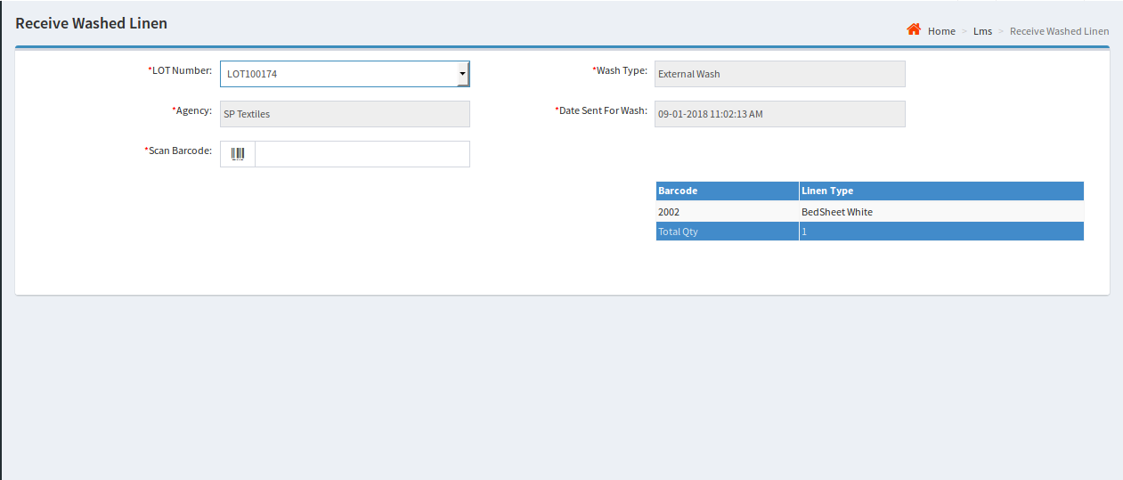
Receive Washed Linen by Linen Department
User can receive Linen from Laundry by selecting LOTNUM which is generated during dispatch of linen for wash and should scan all the received items.
Condemnation: Materials which are damaged will be condemned upon approval from management and the same is updated in the system so that no further transaction can be entertained on the condemned items.

Slide 13
Reports
Our application covers various kinds of reports and some of them are as follows:
Linen Status: In which it shows status of particular item.
Linen Visual Report: It shows to which ward we issued and whether Nursing staff received or not with time.
Stock Position: Displays stock maintenance in respective wards and Linen department.
Condemnation Report: Displays quantity of Linen condemned with date and time.
Laundry Report: Displays the type of material with quantity dispatched to laundry and also shows the vendor details.
Note: All the reports can be exported to Excel and Pdf.

Slide 14
Laundry Reports

Slide 15
Linen Status

Slide 16
Linen Issual Report Linen Issual Report

Slide 17
Stock Position

